Slide 1
Mental Health Workshop
Presented by: Awn Duqoum

Slide 2

Who Am I ?
4th Year Mechatronics student (minor in AI) @ UW
Past coordinator of UW MATES
Heavily involved with the Engineering Society (EngSoc) and FEDS
Done pretty much everything there is do on campus
Big supporter and advocate for mental health!
Notes:
7 Coop terms in various technical areas
Software Dev / Optics by trade

Slide 3
Wait You’re a Student?
Yes, I am not a professional my any means
“So what qualifies you to talk about mental health?”
Trainings I’ve attended as a don, an orientation leader, and a peer counselor
Experience I’ve gained in the office being peer counselor
Personal Experiences
SafeTalk, QRP, MATES Core Training, Mental First-aid

Slide 4
So What are We Going to Talk About?
Introductions
Roadmap
Burnout
Imposter Syndrome
Self Care
How to be an effective peer supporter?
Q&A (There is going to be a lot of time for this, make sure to write your questions down)
Notes:
A reminder to keep anything shared private, safe environment

Slide 5

What is burnout?
Notes:
By definition: Burnout is the result of prolonged exposure to chronic personal and interpersonal stressors on the job.
As determined by three dimensions: exhaustion, cynicism, and professional inefficacy.

Slide 6
What is burnout?
Maslach Burnout Inventory Scales (MBI)
Emotional Exhaustion
Depersonalization
Reduced Personal Accomplishment
Cynicism
Professional Efficacy
Three Types of Burnout:
Frenetic
Underchallenged
Wornout
Notes:
Emotional Exhaustion: measures feelings of being emotionally overextended and exhausted at one's work. Higher scores correspond to greater experienced burnout
Depersonalization: measures an unfeeling and impersonal response toward recipients of one's service, care, treatment, or instruction
Reduced Personal Accomplishment: measures feelings of competence and successful achievement in one's work with people
Cynicism: indifference or a distance attitude towards one's work
Professional Efficacy: measures feelings of competence and successful achievement in one's work
Types of Burnout
Frenetic: Subjects with “frenetic” burnout work increasingly harder to the point of exhaustion in search of success that is equal to the level of stress caused by their efforts.
Underchallenged: Workers with “underchallenged” burnout are presented with insufficient motivation and, given their talents and/or skills,have to cope with monotonous and unstimulating conditions that fail to provide the necessary satisfaction.
Workers with “worn-out” burnout are those who give up when faced with stress or lack of gratification.

Slide 7
Burnout Scenarios
Break into groups (2-3 of the people near you)
Solve the scenario given to your group
What kind of burnout is the student suffering from?
How would you handle burnout if this was you?
How can burnout be prevented?
How can one recover from burnout?
How can the individual find their passion again?
How can the individual prevail through that type of environment?

Slide 8
Scenario 1: EngSoc President
Lily is the President of her Engineering Society. She just got through midterms but is having a lot of trouble catching up with school, managing the Society, and dealing with some curveballs that life threw at her. Her Exec have started to notice that she often replies curtly when they ask for information and want to check in. Lily has noticed that she doesn’t feel as passionate about the Society anymore, she’s beginning to feel jaded. In general, she feels easily frustrated by minor imperfections and is having a hard time staying happy around the Engineering Society office and at events. To top it all off, this is only her first term as President, she still has one more to go.

Slide 9
Scenario 2: EngSoc Executive
Calvin is the Vice President Academic for his Engineering Society. Even though there’s many academic issues to tackle at his school, he is determined to contribute his time to all of them. Since the term started, Calvin has been working extremely long hours, putting school and the Engineering Society above all else. He drinks several coffees every day and hasn’t had a home cooked meal since he left for school. Despite all this hard work, Calvin feels like he isn’t accomplishing very much. The faculty isn’t listening to his concerns and students don’t seem to be passionate about academic issues beyond complaining at Council. His fellow Exec are beginning to notice his lack of concentration in meetings and increased anxiety for Council meetings.

Slide 10
Scenario 3: EngSoc Volunteer
Chris loves his Engineering Society and has for a long time. However, his experiences with the current Executive aren’t great. He has noticed that there isn’t a very good team dynamic, and the Engineering Society has been more about internal drama lately. It’s clear that many of the Executive don’t view him as a good candidate in the upcoming elections. Chris doesn’t understand this because he constantly promotes the Society and has dedicated many hours over his degree to helping the Society grow. He feels extremely underappreciated and isn’t sure if he wants to be involved anymore.

Slide 11
Preventing Burnout
Causes
Resource imbalance
Conflict
Low control
Prevention
Examine your stressors and potential for burnout
Framing in terms of risk
Framing in terms of job-person mismatch
Reduce stressors
Counselling to assist with stressors
Counselling to reduce effects of burnout
Notes:
Do you know your own risk of burnout? Watch out for under accumulation and optimism biases
Framing burnout in terms of risk First, assess what you believe increases or decreases the risk of burnout Second, examine the risks and benefits of all of the options
Framing burnout in terms of job-person mismatch Stress can result from a poor fit between an individual and their role. The larger the mismatch, the higher the risk of burnout.
6 key areas for mismatch: work overload, lack of control, insufficient reward, breakdown of community, absence of fairness, value conflict

Slide 12
Preventing Burnout: Strategies
Time management
Asking for help or delegating to decrease workload
Ensuring work/life balance
Taking care of yourself first
Healthy coping techniques
Avoid isolation and emotional-oriented coping techniques
Task -oriented or control coping is beneficial
Self care (More on this later)
Notes:
Healthy Coping Techniques:
Emotion-oriented coping (i.e., regulating the emotions associated with stressors) has been related to high levels of emotional exhaustion and depersonalization or to high levels of all three burnout symptoms.
Avoidance or escape coping (i.e., avoiding or ignoring stressors) has also been related to high levels of exhaustion, cynicism or all three burnout symptoms.
Instead, task-oriented or control coping (i.e., confronting or addressing stressors) has been associated with low levels of exhaustion and cynicism, or a high level of personal accomplishment

Slide 13
Recovering from Burnout
WHY are you burnt out?
Take care of yourself - food, exercise, SLEEP.
Stop glamorizing unhealthy habits
Are your goals too lofty? Reassess.
Learn to say “no” and to delegate.
Positive thinking.
Talk to a peer or counsellor.

Slide 14
What is Imposter Syndrome?
Imposter syndrome is the idea that you don’t belong in your program / workplace
Start seeing yourself as a fraud
What other signs can you think of?

Slide 15
Why is this a Big Deal?
It affects a lot of us
If left uncheck the idea of being a fraud can start to eat away at your self-confidence
It could leave you at a worse place then when you started
Could lose out on amazing opportunities because you don’t think you are good enough

Slide 16
Who is to Blame?
Imposter Syndrome affects a lot of people in our day an age, so how did we get here? Who is to blame?
There isn’t one source or cause, but the common suspects are
Social media leading people to think everyone else is more successful
People using accomplishments to determine self worth
Goal oriented society
YOU’RE DEGREE OR JOB SHOULD NOT COME AT THE COST OF YOUR MENTAL HEALTH

Slide 17
Strategies to Combat
Time
If you think your a fraud and don’t belong then wait and check that claim
If you don’t think you are fit to be an engineer but graduate then your claim was wrong
Detaching accomplishments from self worth
You are worth more than the sum of your degree and accomplishments
Self-worth needs to come from within not outside
Learning to detach others from yourself
Be happy when people succeed but don’t let it crush your own self confidence

Slide 18
Why Self Care?
No one can take better care then you!
Without proper self care your mental health will suffer when times of stress come along
Having good mental health is like having a sturdy ship, when harsh winds come the ship is not broken
Forgive the bad analogy

Slide 19
Stopping the “Who has it worse” Competitions
Stop glorifying bad self-care
If someone says they only slept 2 hours last night, an effective response is not “oh I only slept 1” a good response is “you should really get more sleep”

Slide 20


Slide 21
Common Self-Care Strategies
8 Hours of sleep
3 Good meals a day
Dedicating time to staying active
Waking up and listing all the things you are looking forward to that day and the things you are proud of achieving yesterday
To do lists
I cannot stress the importance of organization
There is also a lot of joy in scratching something off your to do list
Time management
Not being hard on yourself

Slide 22
7 Pathways to Self-Care from Psychology Today [Dr. Barbara Markway]
Sensory
Focus on the sensations around you
Pleasure
Engage in a pleasurable activity
Mental / Mastery
Do a task you’ve been avoiding or challenge your brain in a new way
Notes:
- (e.g. breath in fresh air, snuggle under a cozy blanket, listen to running water, etc.)
- (e.g. take yourself out to eat, watch a movie, walk your dogs, etc.)
- (e.g. clean out a junk drawer, try a new activity, immerse yourself in a puzzle, etc.)

Slide 23
7 Pathways to Self-Care from Psychology Today [Dr. Barbara Markway]
Spiritual
Get in touch with your values
Emotional
Avoid labelling emotions as good or bad
Physical
Engaging the body bypasses a lot of mental chatter
Notes:
- (e.g. attend church, read poetry or inspiring quotations, write in a journal, etc.)
- (e.g. accept your feelings because they are all okay, write your feelings down, cry when you need to, laugh when you can, practice self compassion)
- (e.g. try yoga, go for a walk or a run, dance, etc.)

Slide 24
7 Pathways to Self-Care from Psychology Today [Dr. Barbara Markway]
Social
Connecting with others is an important part of self-care
Notes:
- (e.g. go on a lunch date with a good friend, call a friend on the phone, participate in a club, etc.)

Slide 25
Being an Effective Peer Supporter
All of us have a desire to help those around us
Not all of us can devote the time and energy into getting formal training
It’s not hard to be a good peer supporter
A good peer supporter can be very effective

Slide 26
Skills that a Peer Support Needs
Active / Empathic listening
Non-judgmental tone
Empathy not sympathy
Knowing when to refer someone

Slide 27
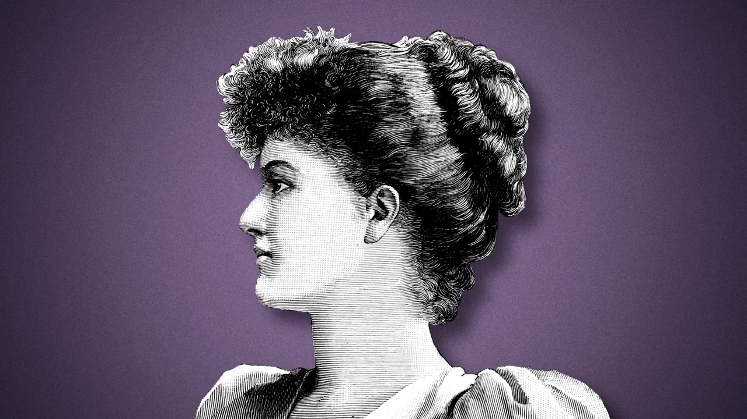

Slide 28
UW MATES – Personal Plug
UW MATES offers peer support to students that is:
Confidential
No wait list
In the language that the student prefers
MATES volunteers receive professional training during core training and continuous training throughout the term

Slide 29
Questions ?

Slide 30
Thank you for coming!
I’ll be uploading this slideshow with speaker notes to my website soon
Leave your email if you want to stay in touch or if you want this slideshow or if you have more
Enjoy the rest of the hackathon!

